Slide 1
The NAtional Trial of Tonsillectomy IN Adults:
a clinical and cost effectiveness study
Launch Event – 6th November 2014
Trial Information and Design
Isabel Rubie – Trial Manager

Slide 2
Trial Management
Institute of Health and Society
Newcastle Clinical Trials Unit

Slide 3
Phases
Feasibility Study
Internal Pilot
Main Trial

Slide 4
Feasibility Summary
Feasibility study recruitment
1st July 2014 – 30th November 2014
Qualitative & Cognitive Interviews
15 ENT patients, 20 ENT staff, 10 GPs
Multi-centre

Slide 5
Study Summary – NATTINA
Multi-centre
Randomised controlled surgical trial
Tonsillectomy vs conservative management
- 1:1 ratio
Recruitment target:
- Internal Pilot - 72 patients (6 months)
- Main Trial - 528 patients (18 months)

Slide 6
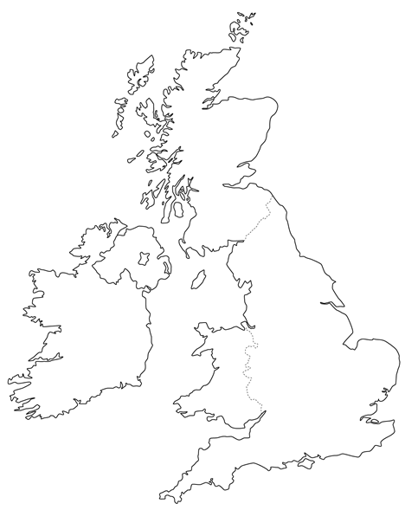
Sites
Aberdeen
2
1
Dundee
2
Glasgow
1
Newcastle
Sunderland
1
York
Bradford
2
3
3
Birmingham
London
3

Slide 7
1
Set up:
November 2014 - December 2014
Set up:
December 2014 - January 2015
Internal Pilot recruitment ends 31st May 2015
Set up:
June 2015
Main Trial recruitment ends 31st December 2016
2
3

Slide 8
Primary Objective
To compare the effectiveness and efficiency of tonsillectomy versus nonsurgical management for recurrent acute tonsillitis

Slide 9
Objectives
Clinical Effectiveness
2) Economic Evaluation
Qualitative Process Evaluation
Future Research

Slide 10
Inclusion Criteria
Age ≥ 16 years
Recurrent sore throats which fulfil current SIGN guidance for elective tonsillectomy
Patient has provided written informed consent for participation in the study prior to any study specific procedures

Slide 11
Exclusion Criteria
Under 16 years of age
Previous tonsillectomy
Listed directly during emergency admission
Inability to complete self-reported questionnaires & returns
Tonsillectomy required for other indications:
Equipoise influenced by other clinical considerations:
Primary sleep breathing disorder
Suspected malignancy
Tonsilloliths
Pregnant or breastfeeding
Bleeding diathesis
Therapeutic anticoagulation

Slide 12
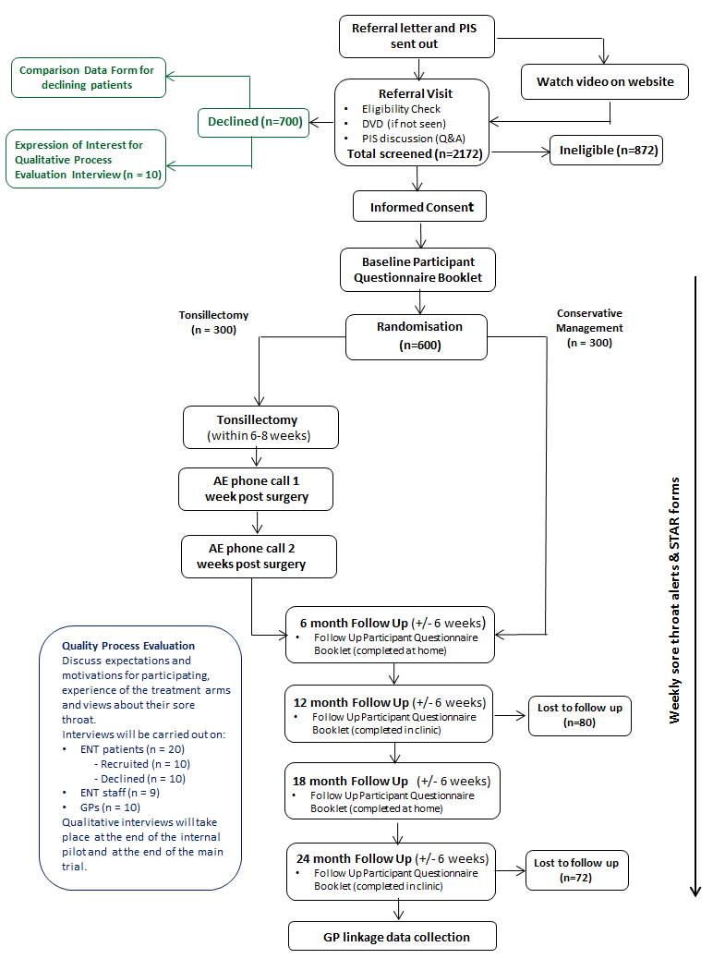
Process Flowchart

Slide 13
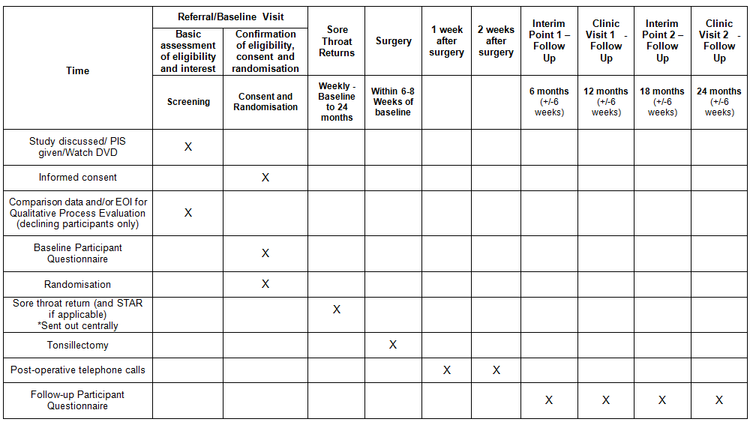
Schedule of Events

Slide 14
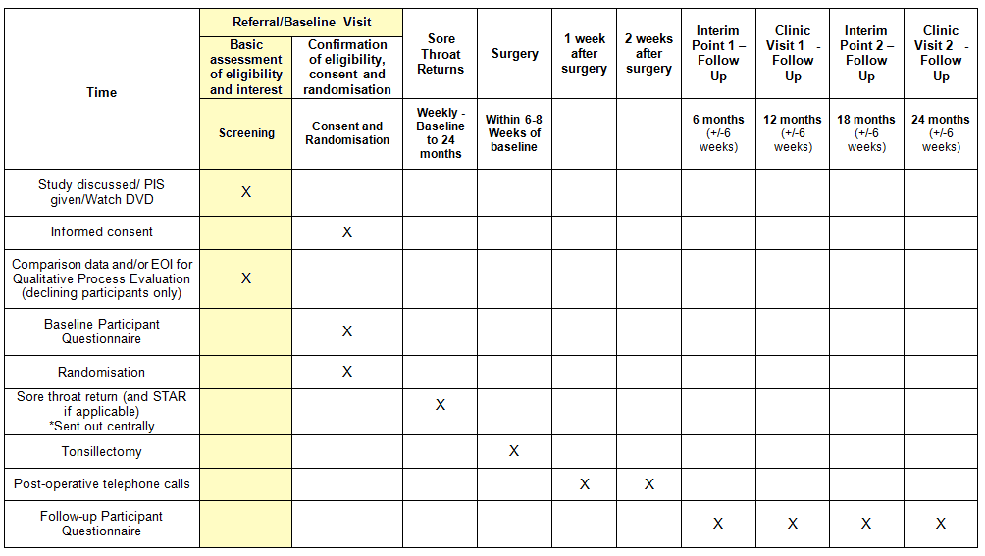
Screening

Slide 15
Screening
All patients who attend an ENT clinic visit having been referred by a GP for recurrent sore throat
PIS posted to patients with confirmation of their clinic appointment
Activities at screening:
Eligibility check
Discussion & Information DVD
Screening log

Slide 16
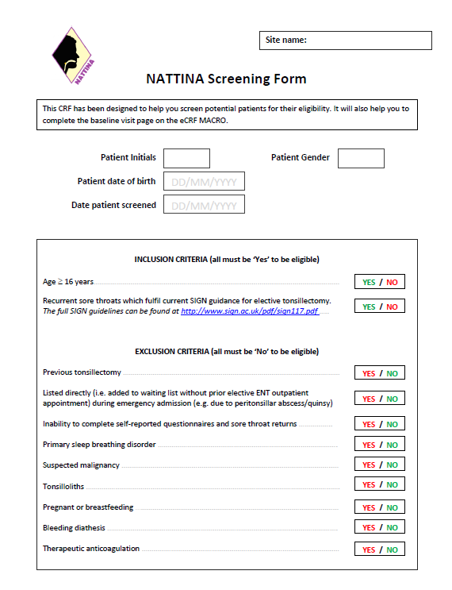
Screening Form

Slide 17
Declining Patients
Offered:
Record reasons for decline on screening log
Comparison Data Form
Qualitative interview with a researcher

Slide 18
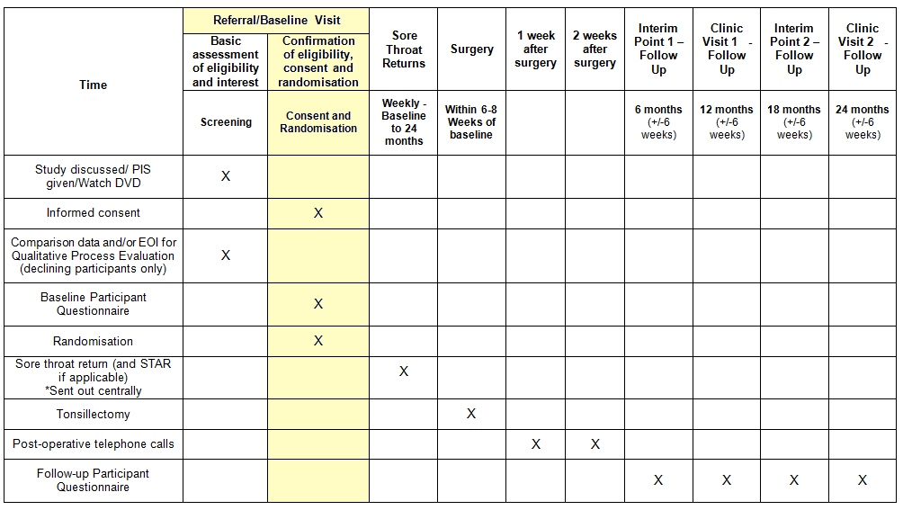
Consent & Randomisation

Slide 19
Consent & Randomisation
1) Consent
Eligible patients only
Consent form must be signed before the baseline questionnaire / randomisation
2) Baseline Questionnaire Pack
NCTU online randomisation: https://apps.ncl.ac.uk/random/
Stratified by centre and severity (TOI 14)
4) Participant Contact Details Form
3) Randomisation

Slide 20
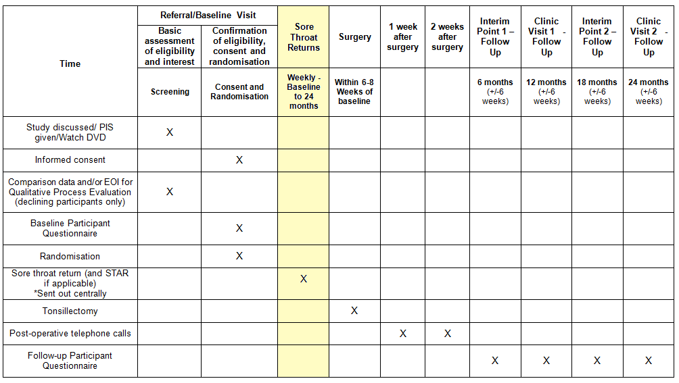
Weekly Alerts & STARs

Slide 21
Weekly Alerts & STARs
Weekly alerts:
No. of sore throat days over previous 7 days
SMS / Email / IVR
STAR (Sore Throat Alert Return)
When patient experiences a sore throat
Requests information on:
- Severity
- Use of over-the-counter / prescription medications
- Healthcare advice sought
- No. of hours unable to perform usual daily activities
- SF-12

Slide 22
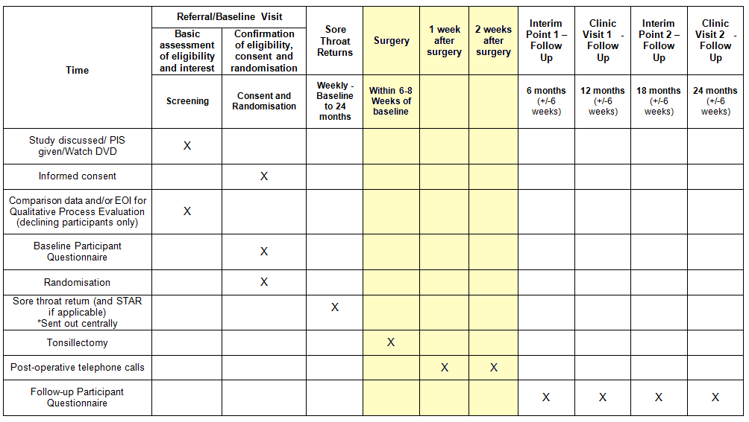
Surgery

Slide 23
Surgery
‘Immediate Tonsillectomy’ participants only
Within 6-8 weeks of randomisation
Phone calls at 1 & 2 weeks post surgery

Slide 24
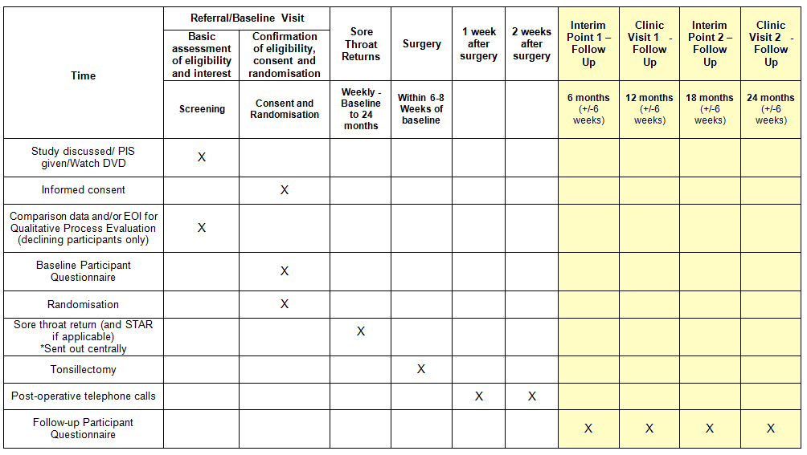
Follow-Up

Slide 25
Follow-Up
6 month & 18 month follow up
- Follow up questionnaire pack (home)
12 month & 24 month follow up visit
- Follow up questionnaire pack (clinic)
- Assessment on willingness to remain in
deferred surgery group
+

Slide 26
Adverse Events
Any untoward medical occurrence in a subject to whom a study intervention has been administered
AEs to be collected:
Events / reactions during surgery or before discharge
Events / reactions reported by patient at 1 and 2 week post-surgery follow up telephone calls
Recorded in electronic CRF

Slide 27
Serious Adverse Events
Any untoward occurrence (expected or not) that:
Results in death
Is life threatening
Requires hospitalisation / prolongation of existing hospitalisation
Results in persistent / significant disability / incapacity
Trial Manager / CI must be notified within 24 hours
of site being made aware
SAE reported using SOHO 66: Fax: 0191 580 1106

Slide 28
GP Linkage Data
Aim: To collect primary health care usage data to support weekly returns / STAR data / questionnaires / post-operative follow up calls
Collected after 24 month follow up
Covers 24 month enrolment + 6 months prior to recruitment
Data collection arranged with GP via NCTU / LCRN
Data to be collected:
- Adverse Events*
- Attendance to GP / walk in clinic / A&E*
- Hospitalisations / emergency referrals*
- Prescriptions issued*
- Any additional interventions*
*due to sore throat or related event

Slide 29
Questions?
Anything not covered today will be covered in more detail at your Site Initiation Visit
For further information please contact:
Isabel Rubie (Trial Manager)
Newcastle Clinical Trials Unit
Telephone: 0191 208 7252
Email: isabel.rubie@newcastle.ac.uk
Fax: 0191 222 8901
This project was funded by the National Institute for Health Research (NIHR) Heath Technology Assessment (HTA Programme (project number 12/146/06). The views and opinions expressed therein are those of the authors and do not necessarily reflect those of the HTA, NIHR, NHS or the Department of Health.

